Slide 1
September OPEN+
Advanced Presentation Techniques

Slide 2
OPEN+
Discussion Questions
1) What are the essentials of making effective virtual presentations?
2) What might be considered an effective presentation technique in your culture, but not in other cultures?
3) Are there any specific presentation techniques/elements required at Micron?

Slide 3
Advanced Presentation Techniques
One slide, one message
If you find yourself making more than one key point on one slide, split the slide into 2/3 slides.
Create a take-home message!
How?
Example
Example
Example

Slide 4
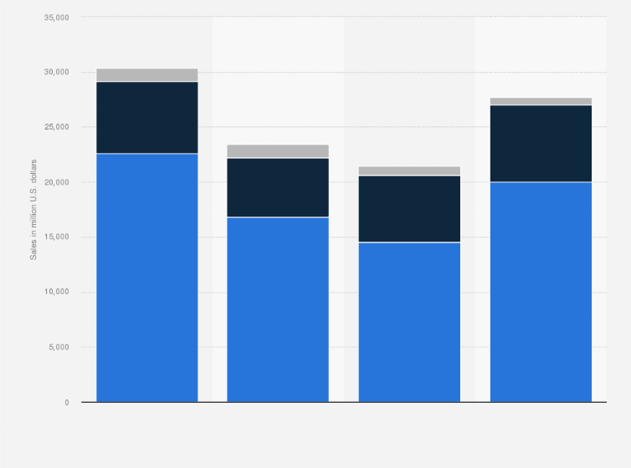
Advanced Presentation Techniques (Micron Practice)
2018
2019
2020
2021
DRAM
NAND
Other - (3D Xpoint Memory or NOR)

Slide 5
Advanced Presentation Techniques
Convince your audience
Rhetorical techniques can help create a more engaging presentation.
Let’s focus on two here: Repetition and Rhetorical questions.
What are these?
Repetition - Simply repeat your key point (”To repeat [MAIN POINT]
Rhetorical question - So, how can we solve this problem? Well, I believe we can…

Slide 6
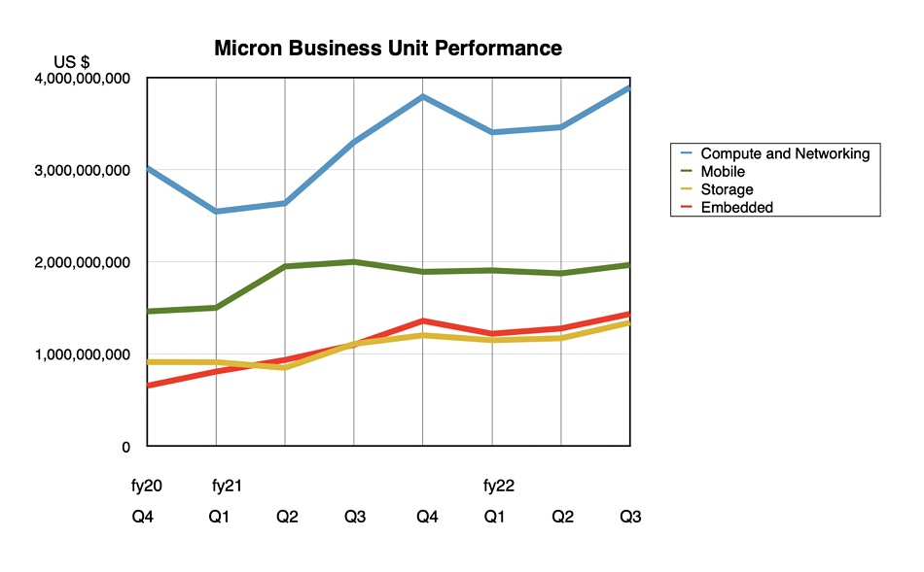
Advanced Presentation Techniques (Micron Practice)

Slide 7
Strategies & Workshop Takeaways
Key points
1) One slide, one message (and create an effective, one-line, key message before moving on to the next slide)
2) Employ rhetorical devices to engage audience (repetition, question & answer pairs etc.)

