Slide 1
August OPEN+
Disagreeing Across Cultures

Slide 2
OPEN+
Discussion Questions
1) What differences have you noticed between cultures when disagreeing?
2) What shouldn’t we do in China/Korea/Japan if we disagree with someone?
3) What is hardest for you when someone from America/Europe disagrees with you?

Slide 3
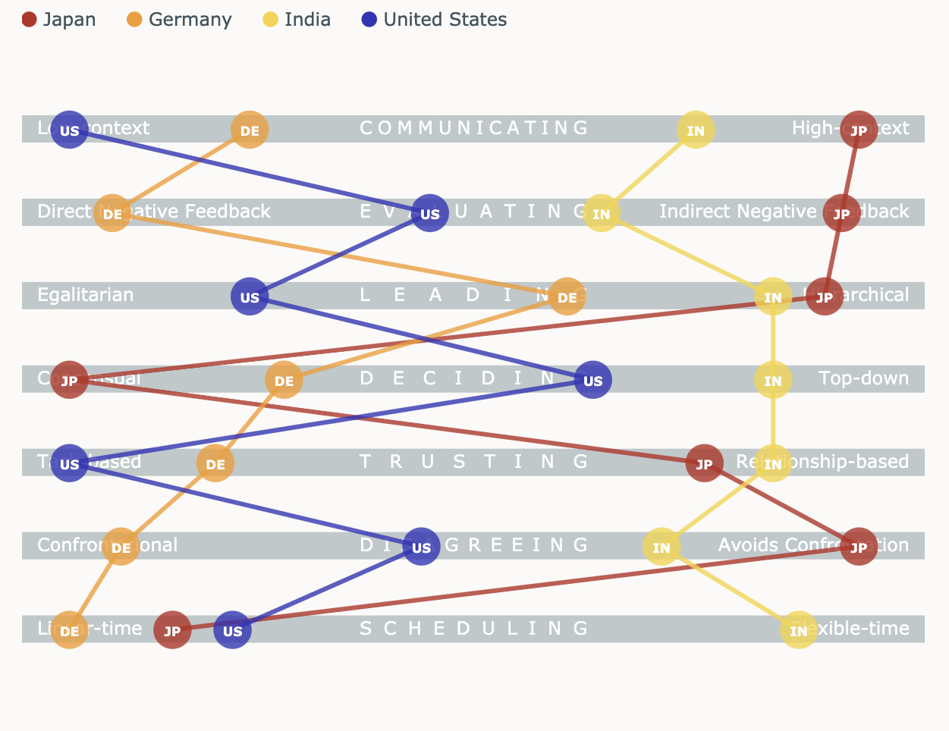
Disagreeing Across Cultures

Slide 4
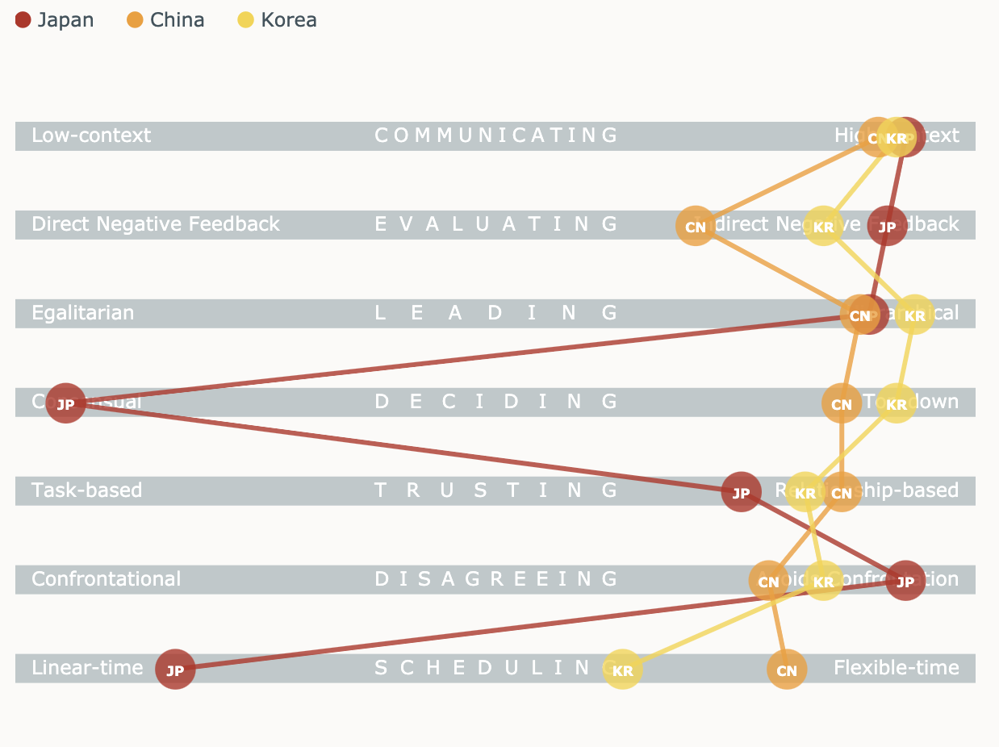
Disagreeing Across Cultures

Slide 5
Disagreeing Across Cultures
Scenario: Disagreeing
You are trying to set a deadline for an upcoming project with a group of TMs in Boise. You think your team won’t need much time to complete the issue. One of your coworkers in Boise strongly disagrees. In front of everyone at the meeting, he says “I totally disagree with you and your schedule.”
How do you respond to this?
What would you say if you disagreed with his/her proposed timeline?
Boise team member
Japanese team member
Confrontational
Avoids Confrontation

Slide 6
Strategies & Workshop Takeaways
If you’re from a non-confrontational culture…
1) Understand that a German, French, American person saying “I totally disagree with you” isn’t an attack on you personally.
2) Adapt your way of disagreeing to your coworker’s style. (German = Using stronger modifiers/more direct language).
3) Consider playing “Devil’s advocate.” This means to (on purpose) consider both sides even if you disagree. Frame your language by saying “Let me play devil’s advocate so we can explore both sides.”

Slide 7
Strategies & Workshop Takeaways
If you’re from a confrontational culture…
1) Depersonalize your disagreements. Avoid emphasis on “I” and “You.”
2) Consider holding a premeeting to ensure that everyone in the main meeting is not surprised by your sudden disagreement.
3) Consider playing “Devil’s advocate.” This means to (on purpose) consider both sides even if you disagree. Frame your language by saying “Let me play devil’s advocate so we can explore both sides.”

