Slide 1
Micron May OPEN+ Strategies For Multicultural Collaborations

Slide 2
OPEN+
Discussion Questions
1) Have you worked on a global project before? What did you learn about other culture’s way of collaborating?
2) What do you think is most important when planning or working on projects across cultures? (keeping to deadlines, managing expectations etc.)

Slide 3
Deciding - Big ”D” or Little ”D?”
D (Top-
down)
Decision
Implementation, Changes & Discussion
d
(Consensual)
Discussion
Decision

Slide 4
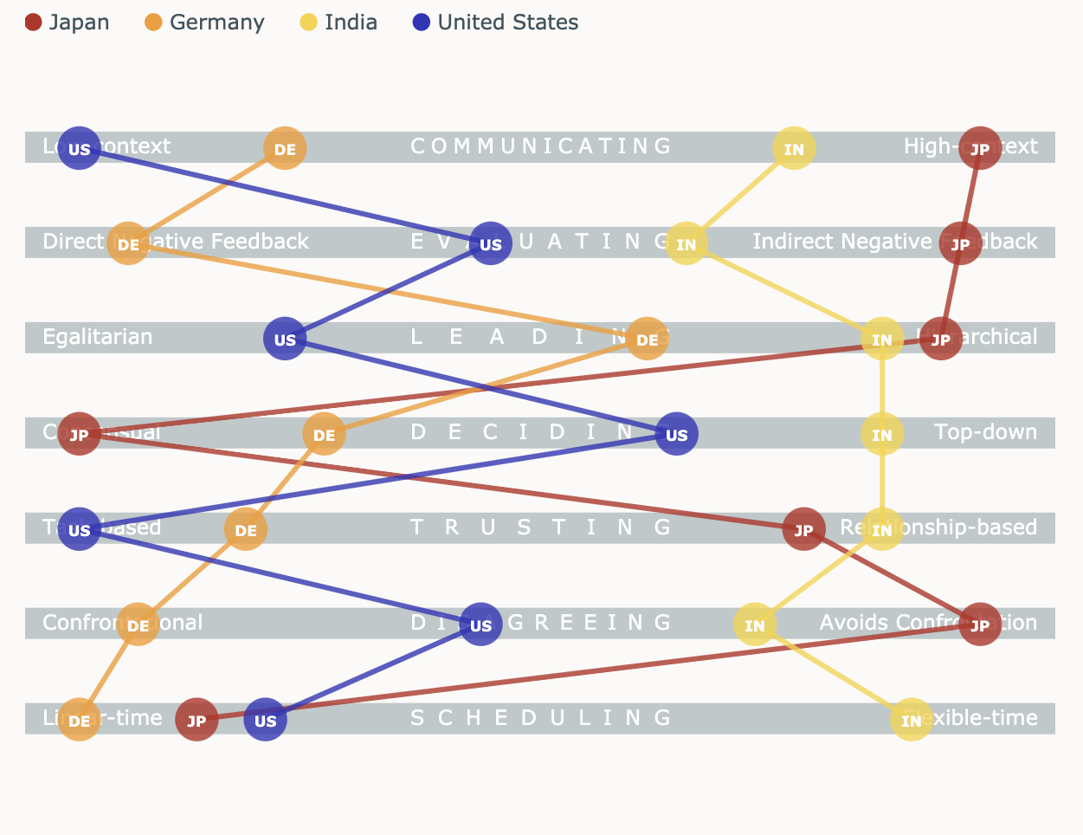
Deciding - Big ”D” or Little ”D?”

Slide 5
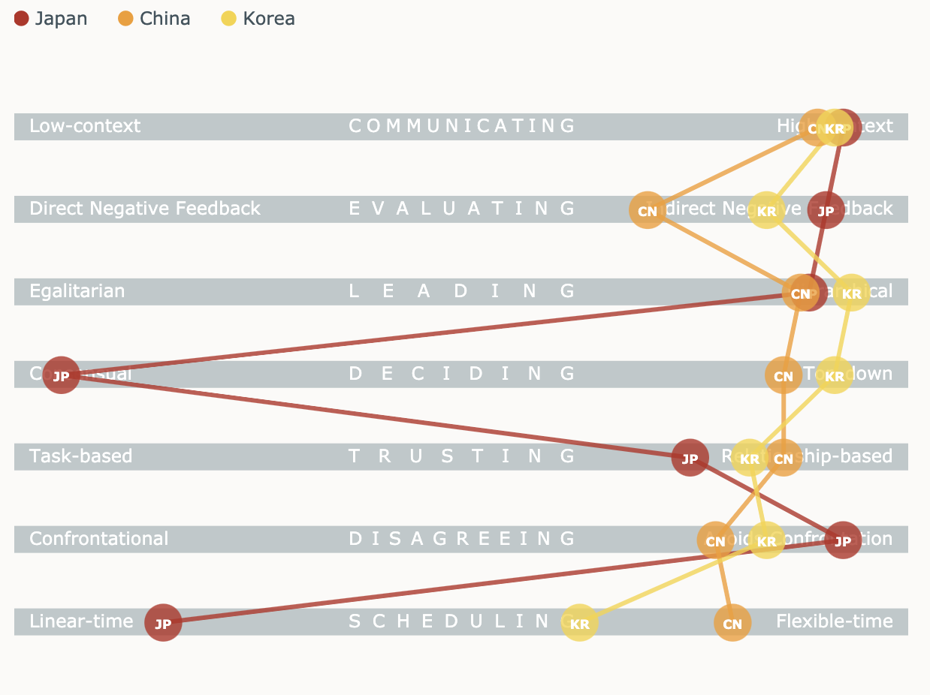
Deciding - Big ”D” or Little ”D?”

Slide 6
Practice
Scenario: Decision-making
“Why does my colleague in Boise always make a decision on an important timeline without asking for my opinion?”
You are meeting your team members in Boise to talk about an important project but realize that the timeline has already been decided by the team leader before the meeting. How could you make her/him aware of your cultural style of decision making?
You
Team leader
Top-down
Consensual

Slide 7
Strategies & Workshop Takeaways
Strategies for Multicultural collaborations (working with top-down cultures)
1) Expect decisions to be made by one person (often the boss) with less discussion 2) Be ready to follow a decision that does not include your input 3) If you are in charge, try to get input but also strive to make decisions quickly 4) When the group is divided, suggest a vote 5) Remain flexible, decisions are rarely set in stone

Slide 8
Strategies & Workshop Takeaways
Strategies for Multicultural collaborations (working with consensual cultures)
1) Expect the decision-making process to take longer and involve more meetings and correspondence 2) Be patient, even when opinions diverge 3) Check in with your counterparts regularly to show your commitment 4) Cultivate informal contacts within the team to monitor the progress of decision-making 5) Resist the temptation to push for a quick decision

