Slide 1
Micron March OPEN+ - Direct & Indirect Negative Feedback

Slide 2
OPEN+
Discussion Questions
1) How do most Japanese/Chinese people give negative feedback?
2) Are Americans direct when giving negative feedback?
3) What is your approach to giving negative feedback?

Slide 3
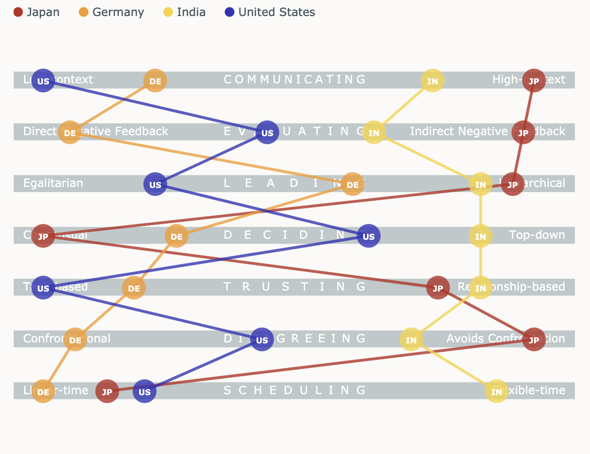
Direct vs. Indirect Negative Feedback

Slide 4
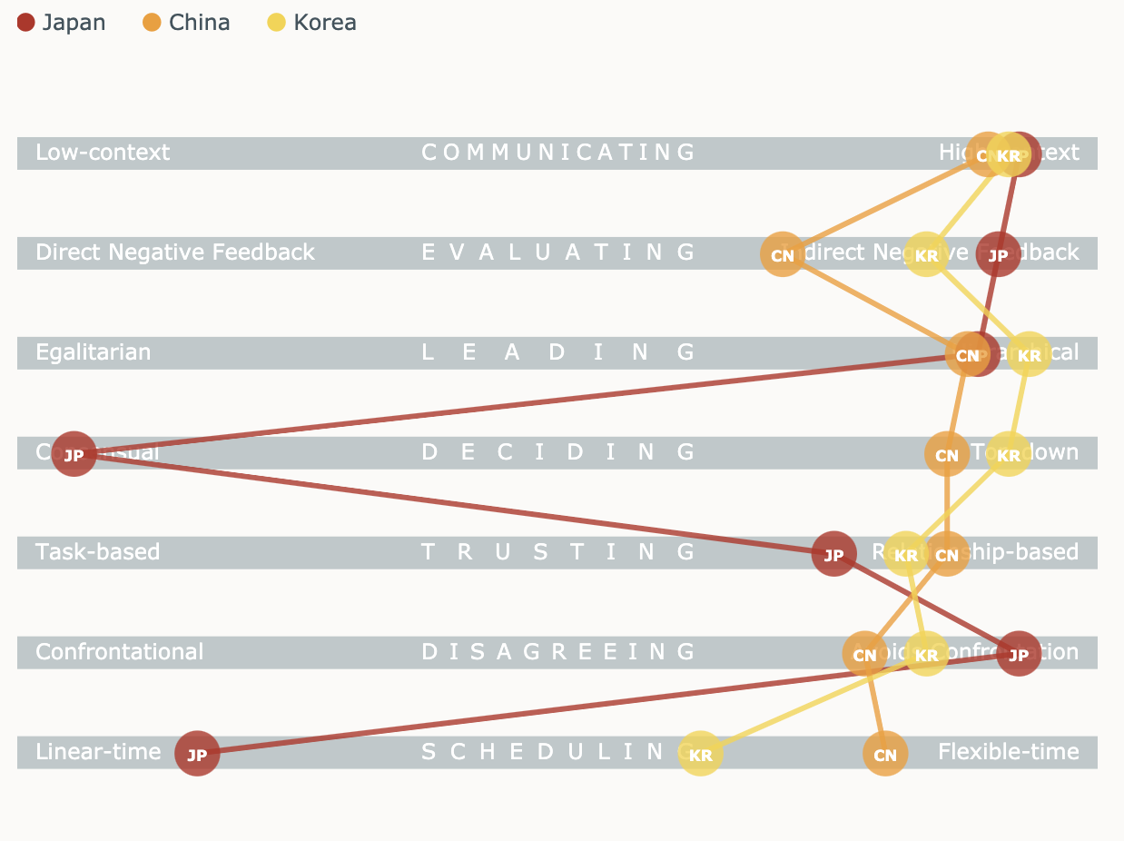
Direct vs. Indirect Negative Feedback in Asia

Slide 5
Scenario: Negative Feedback
Linda manages a team of 4 Japanese members. In her yearly appraisal meetings, she must give feedback on annual performance. This year, one of her team members her performed poorly (many absences, poor communication and attitude). Imagine you are Linda and tell us how you would approach the appraisal meeting.
Linda
Japanese team member
Negative
Feedback
Indirect Negative Feedback

Slide 6
The Feedback Sandwich: Yes or No?
The feedback sandwich consists of:
Positive feedback
Negative feedback
Positive feedback
It is a popular tool among Americans and Canadians to give negative feedback.
However, some direct negative feedback cultures such as Germany and France find it confusing as it sounds too positive.
For direct negative feedback cultures, getting straight to the point followed by practical advice is the best approach.

Slide 7
Workshop Takeaways
For Americans, Canadians and British (indirect negative feedback cultures), consider using the Feedback Sandwich to frame your negative feedback.
For Germans, French, Russian and other European nations) not Scandinavian cultures though!) consider being more direct by giving the negative feedback and then practice advice.
For Asian cultures…well, you’re the experts!

